Slide 1

Exploratory Data Analysis
NLP Resume Extraction
11/16/2023

Slide 2

Team
Name: Ritu Kukreja
Email: rk977@drexel.edu
Country: United States
College/Company: Drexel University

Slide 3
Agenda
Executive Summary
Problem Statement
Approach
EDA
EDA Summary
Recommendations

Slide 4
Executive Summary
My project, titled "NLP Resume Extraction" revolves around the exploration and analysis of a dataset containing crucial information from resumes. The primary objective is to derive meaningful insights that can aid in making informed decisions and strategizing effectively.

Slide 5
Problem Statement
The challenge lies in extracting valuable information from diverse resumes, understanding trends, and identifying patterns that can contribute to better decision-making processes. Additionally, the dataset may pose challenges such as missing values, outliers, and varying data formats.

Slide 6
Approach
My approach involves a comprehensive data exploration process to understand the underlying structure of the dataset. I address missing values, outliers, and conduct a thorough Exploratory Data Analysis (EDA) to uncover key trends and patterns. Leveraging various visualization techniques, I aim to present a clear picture of the data.

Slide 7
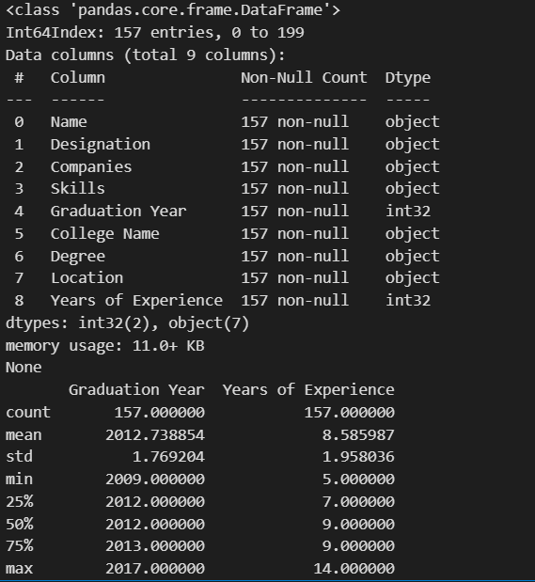
EDA (Exploratory Data Analysis)
Summary Statistics
I initiated the exploration by computing summary statistics, providing an overview of the dataset's composition and structure.
# Task 1: Summary Statistics
print(resume_df.info())
print(resume_df.describe())

Slide 8
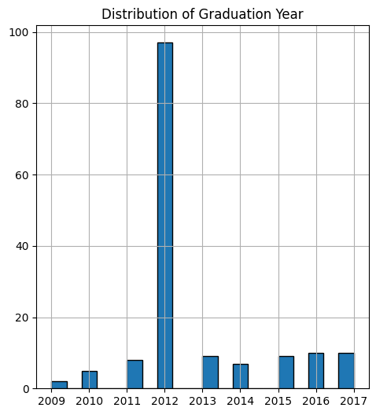
EDA (Exploratory Data Analysis)
Distribution of Numerical Features
Visualizing the distribution of numerical features like 'Graduation Year' allows us to understand the temporal aspects of the dataset.

Slide 9
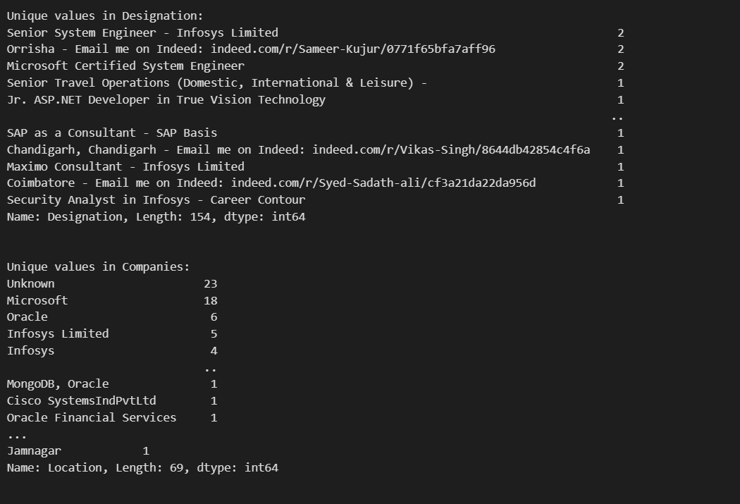
EDA (Exploratory Data Analysis)
Categorical Feature Exploration
Exploring categorical features such as 'Designation,' 'Companies,' 'Skills,' 'College Name,' 'Degree,' and 'Location' unveils insights into the diversity and prevalence of different categories.

Slide 10
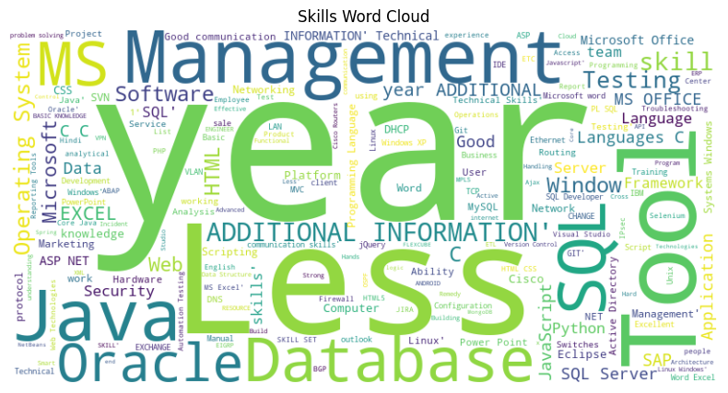
EDA (Exploratory Data Analysis)
Skills Analysis (Word Cloud)
A Word Cloud analysis of skills offers a visual representation of the most frequently mentioned skills in the dataset.

Slide 11
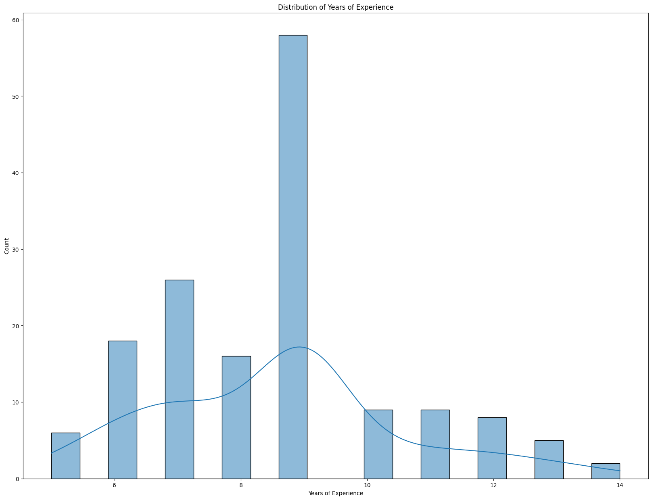
EDA (Exploratory Data Analysis)
Experience Analysis
Analyzing the distribution of 'Years of Experience' provides insights into the workforce's experience levels.

Slide 12
EDA Summary
The EDA process has provided valuable insights into the dataset's composition, revealing trends and patterns that can inform strategic decisions. Key findings include the distribution of skills, geographic preferences, and the prevalence of professionals from top companies and educational institutions.

Slide 13
Recommendations
Based on the EDA results, I found leveraging the identified trends for strategic planning, talent acquisition strategies, and educational partnerships. Additionally, addressing outliers and refining data quality processes will enhance the reliability of future analyses.

Slide 14
Thank You

